Slide 1
CER PoC System Architecture
1/23/2025 mrh

Slide 2
Options
STM32
Custom PCBA and firmware
SPI or MIPI Touchscreen
SBC – NUC or similar
Custom PCBA and firmware
HDMI Touchscreen
Raspberry PI
Custom PCBA – no firmware
HDMI or MIPI Display

Slide 3
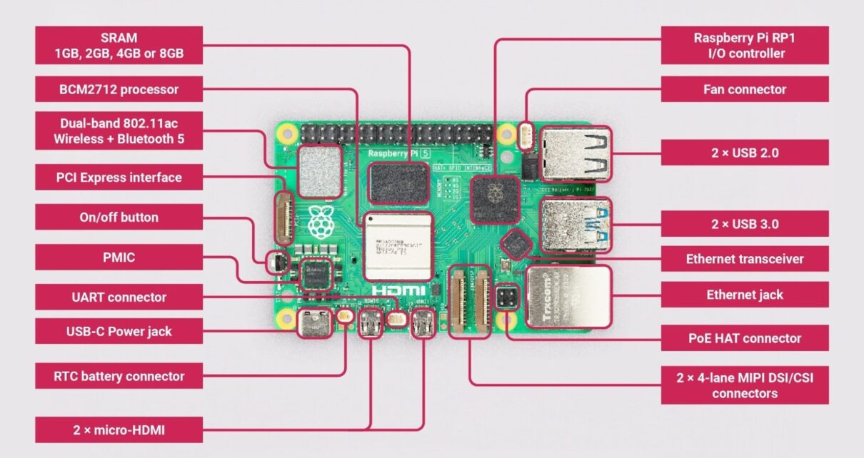
Rpi 5 Functions

Slide 4
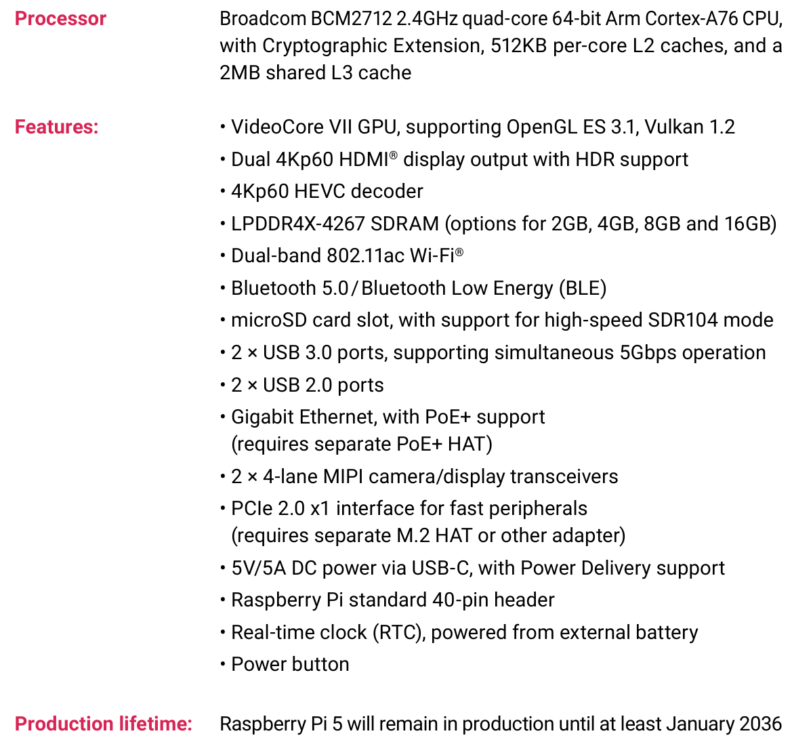

Rpi 5 Specs

Slide 5
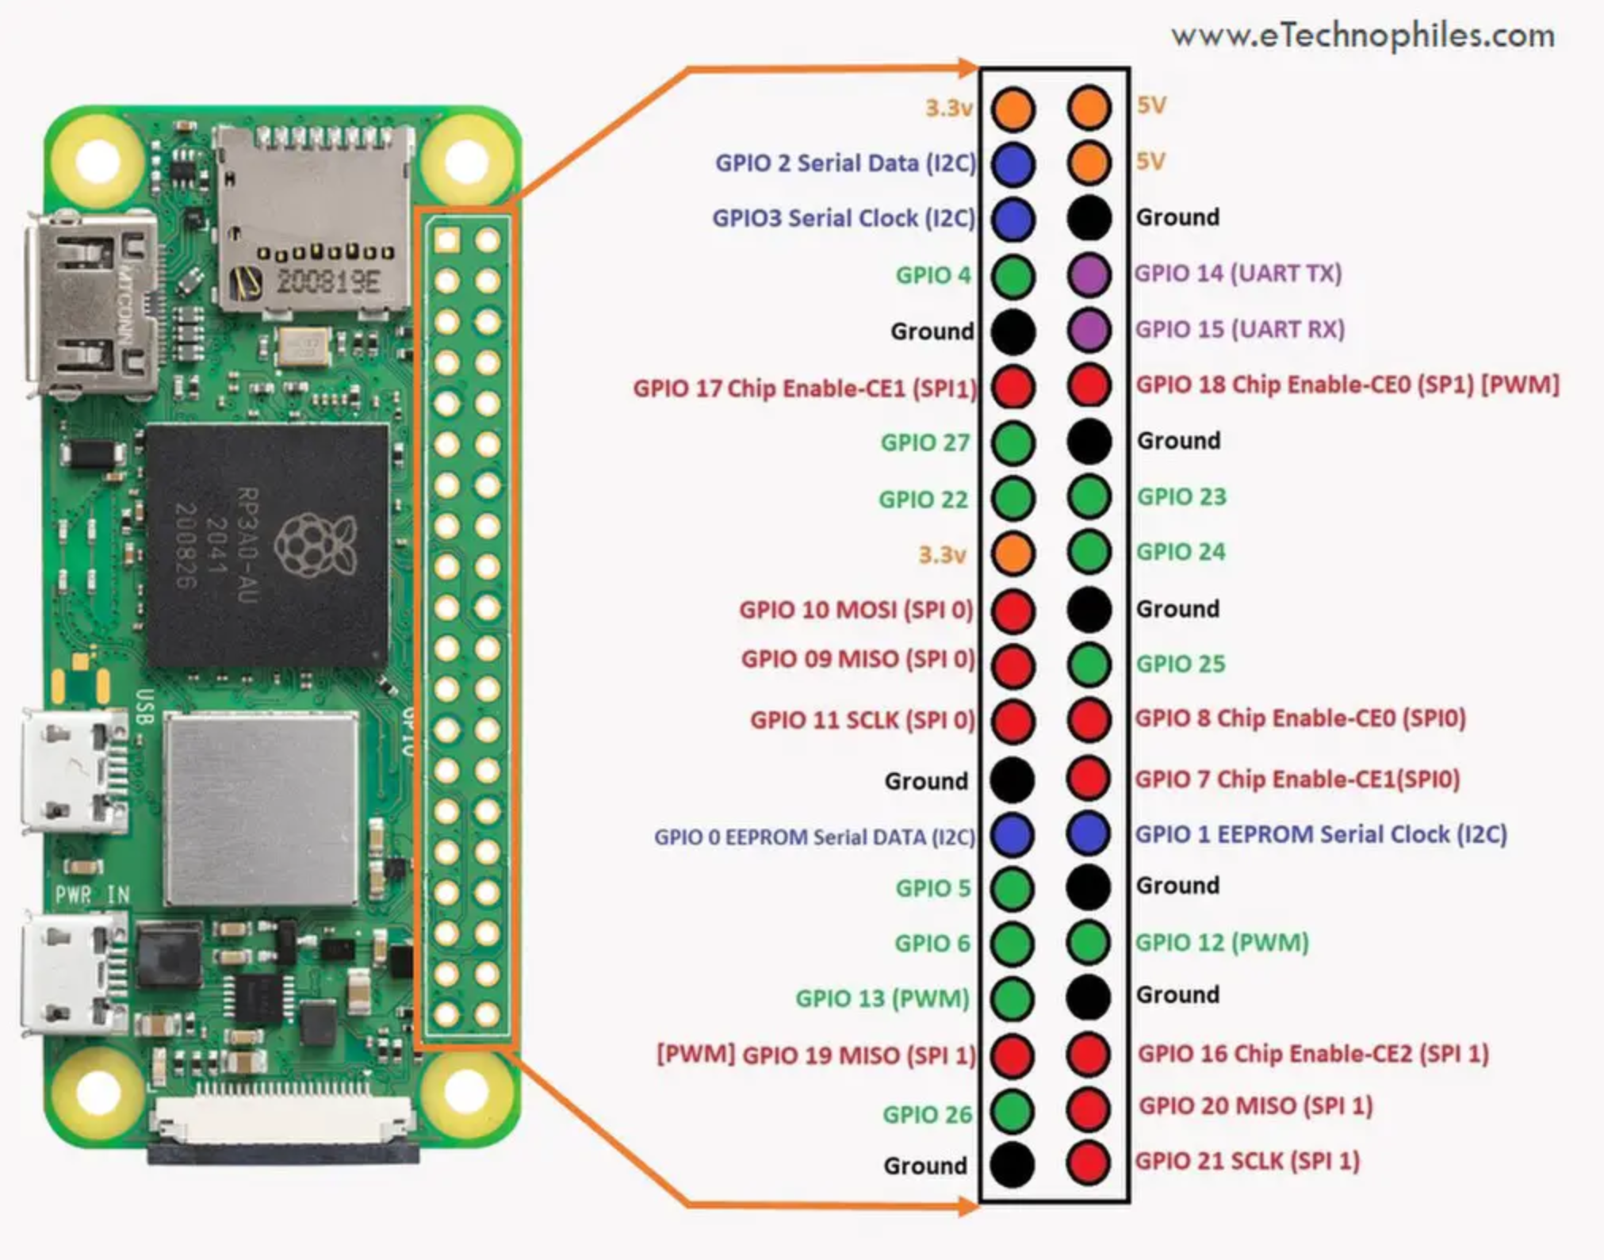
40 Pin connector
1x I2C
2x SPI
2x PWM
GPIO
Notes:
+

Slide 6
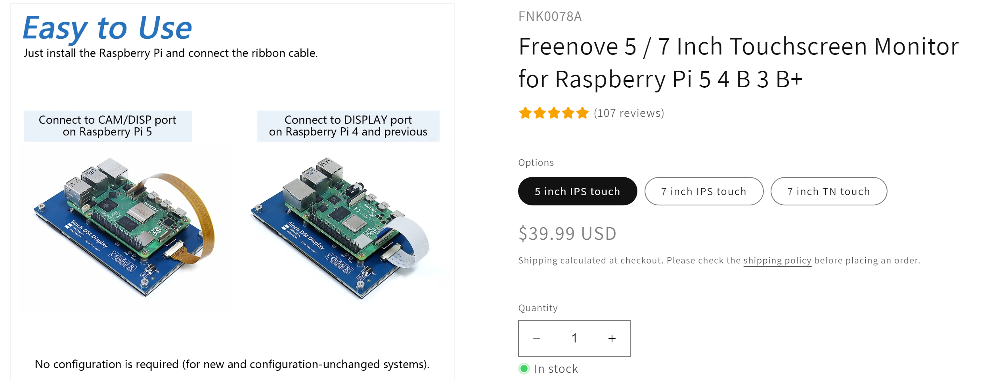
Touchscreen

Slide 7
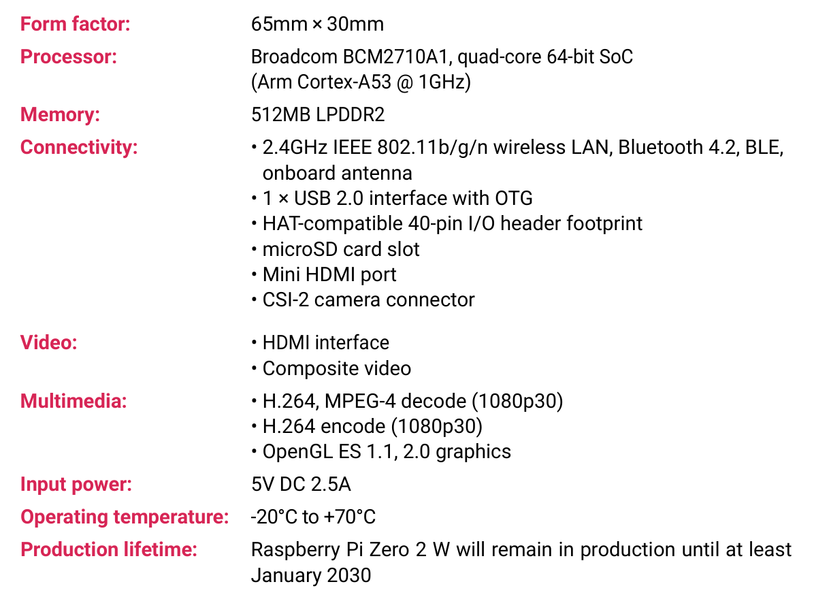
Rpi Zero 2 W - $15

Slide 8
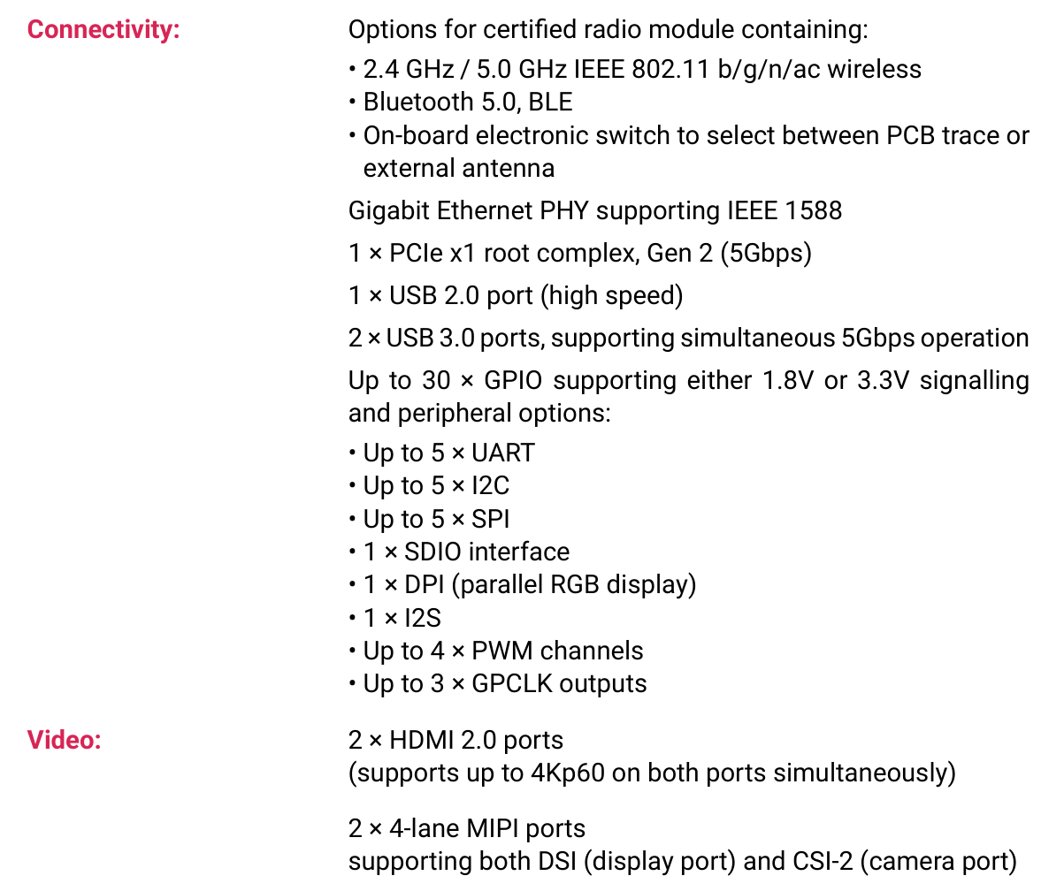

Rpi 5 Compute Module Specs $50-$95

Slide 9
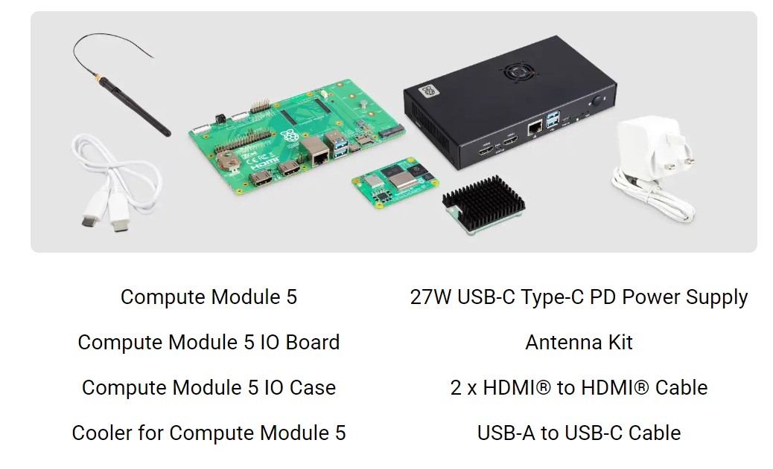
Rpi 5 Compute Module Development Kit

Slide 10
Rpi Software
Raspberry Pi OS – Based on Linux Debian
Remote debugging with Visual Studio on Laptop
C# With Avalonia cross-platform XAML based GUI framework
Microsoft GPIO library compatible with Rpi

Slide 11
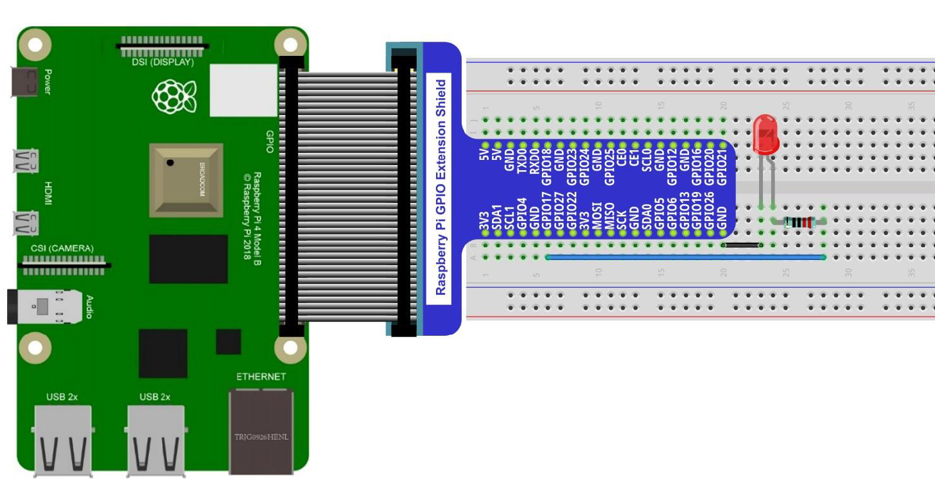
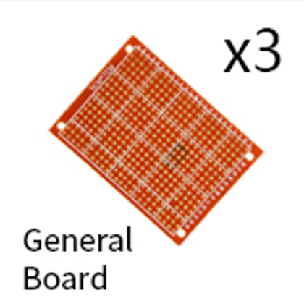
Prototyping

Slide 12
